Slide 1

B.Tech 7th Semester Major project presentation
“Intelligent farming Solution”
Presented by:
Parthiv Patel - 210305125009
Prem Malviya - 210305125008
Tushar Sharma - 210305125017
Deep Maheshwari -
Supervisors:
Prolay biswas
PARUL INSTITUTE OF TECHNOLOGY, PARUL UNIVERSITY
NAME OF THE INSTITUTE, PARUL UNIVERSITY

Slide 2
Broad Outline/Background/Problem Statement
With the exponential growth of world population, according to the UN Food and Agriculture Organization, the world will need to produce 70% more food in 2050, shrinking agricultural lands, and depletion of finite natural resources, the need to enhance farm yield has become critical.
Availability of natural resources such as fresh water and arable land along with slowing yield trends in several staple crops, have further aggravated the problem.
Moreover, agricultural labor in most of the countries has declined. As a result of the declining agricultural workforce, adoption of internet connectivity solutions in farming practices has been triggered, to reduce the need for manual labor
NAME OF THE INSTITUTE, PARUL UNIVERSITY
NAME OF THE INSTITUTE, PARUL UNIVERSITY

Slide 3
Introduction
IoT based agriculture solutions are focused on helping farmers close the supply demandgap, by ensuring high yields, profitability, and protection of the environment. The approach of using IoT technology to ensure optimum application of resources to achieve high crop yields and reduce operational costs is called precision agriculture. IoT in agriculture technologies comprise specialized equipment, wireless connectivity, software and IT services.
The farmers can monitor the field conditions from anywhere. They can also select between manual and automated options for taking necessary actions based on this data.IoT have the potential to transform agriculture in many aspects and these are the main ones.
Data collected by smart agriculture sensors, in this approach of farm management, a key component are sensors, control systems, automated hardware, variable rate technology, motion detectors, button camera, and wearable devices.
NAME OF THE INSTITUTE, PARUL UNIVERSITY
NAME OF THE INSTITUTE, PARUL UNIVERSITY

Slide 4
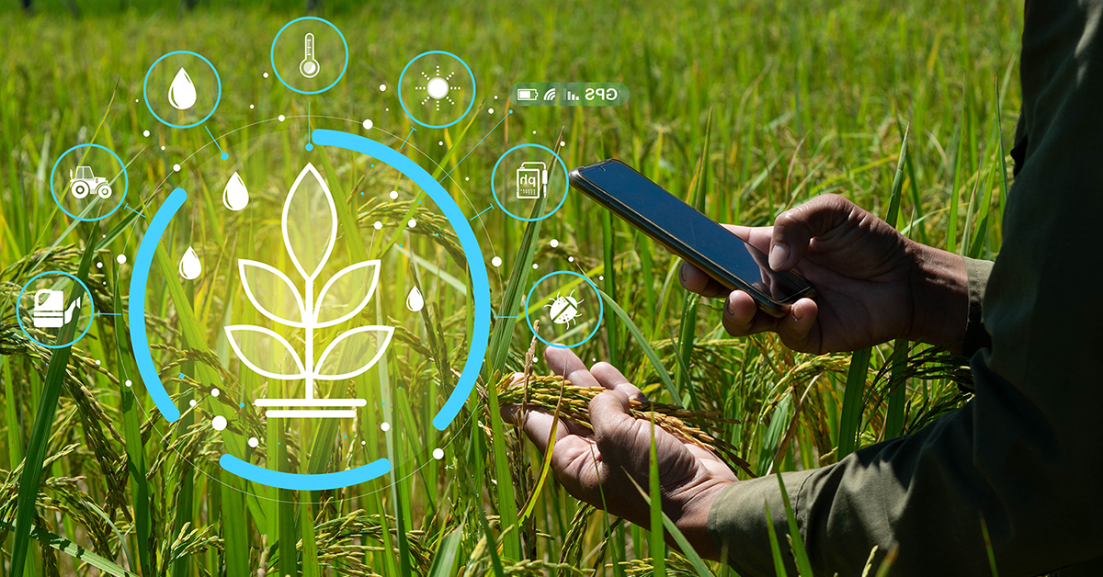
Introduction
IoT in agriculture enables farmers to remotely monitor field conditions and automate tasks based on real-time data, leading to improved efficiency, sustainability, and overall crop management.
NAME OF THE INSTITUTE, PARUL UNIVERSITY
NAME OF THE INSTITUTE, PARUL UNIVERSITY

Slide 6
Aim and Objectives of Study
NAME OF THE INSTITUTE, PARUL UNIVERSITY
NAME OF THE INSTITUTE, PARUL UNIVERSITY

Slide 7
Novelty/Problem Justification
NAME OF THE INSTITUTE, PARUL UNIVERSITY
NAME OF THE INSTITUTE, PARUL UNIVERSITY

Slide 8
Literature Review (if any)
NAME OF THE INSTITUTE, PARUL UNIVERSITY
NAME OF THE INSTITUTE, PARUL UNIVERSITY

Slide 9
Proposed Methodology
NAME OF THE INSTITUTE, PARUL UNIVERSITY
NAME OF THE INSTITUTE, PARUL UNIVERSITY

Slide 10
DFD / ER DIAGRM
NAME OF THE INSTITUTE, PARUL UNIVERSITY
NAME OF THE INSTITUTE, PARUL UNIVERSITY

Slide 11
Hardware & Software Detail
Software Detail
Front End:
Back End:
Hardware Detail
NAME OF THE INSTITUTE, PARUL UNIVERSITY
NAME OF THE INSTITUTE, PARUL UNIVERSITY

Slide 12
Work Plan/Time line
NAME OF THE INSTITUTE, PARUL UNIVERSITY
NAME OF THE INSTITUTE, PARUL UNIVERSITY

Slide 13
Approximate Budget (if any)
NAME OF THE INSTITUTE, PARUL UNIVERSITY
NAME OF THE INSTITUTE, PARUL UNIVERSITY

Slide 14
GUI
NAME OF THE INSTITUTE, PARUL UNIVERSITY
NAME OF THE INSTITUTE, PARUL UNIVERSITY

Slide 15
Future Scope
NAME OF THE INSTITUTE, PARUL UNIVERSITY
NAME OF THE INSTITUTE, PARUL UNIVERSITY

Slide 16
Prons & Cons
NAME OF THE INSTITUTE, PARUL UNIVERSITY
NAME OF THE INSTITUTE, PARUL UNIVERSITY

Slide 17
Conclusion
NAME OF THE INSTITUTE, PARUL UNIVERSITY
NAME OF THE INSTITUTE, PARUL UNIVERSITY

Slide 18
References
NAME OF THE INSTITUTE, PARUL UNIVERSITY
NAME OF THE INSTITUTE, PARUL UNIVERSITY

